Slide 1

Reinforcement Learning with Demonstrations
Kai Yan
Coordinated Science Lab
Department of Computer Science
University of Illinois at Urbana-Champaign

Slide 2
Overview
Reinforcement Learning: A Quick Recap
What is Demonstration?
Why Demonstration?
What To Learn from Demonstration?
Policy: Behavioral Cloning
Reward function: Inverse RL
Policy, but segmented: Skill-based Learning
Transition model: Transition Model Retrieval
How to use Learned Policy?
Directly
Hierarchical
RL Regularizer
Normalizing-Flow Based
Conclusion & Takeaways
Notes:
Though I am talking about RL, this presentation will focus more on things that are not so “RL”, i.e. not so many tricks on Bellman equation.
Instead, we will focus more on general “representation of trajectories”

Slide 3
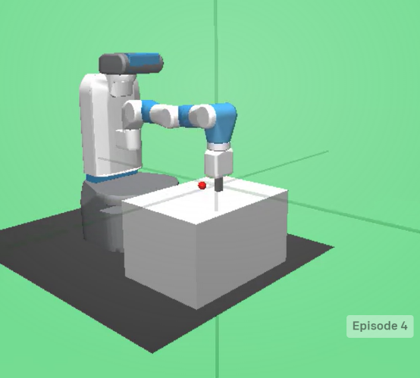
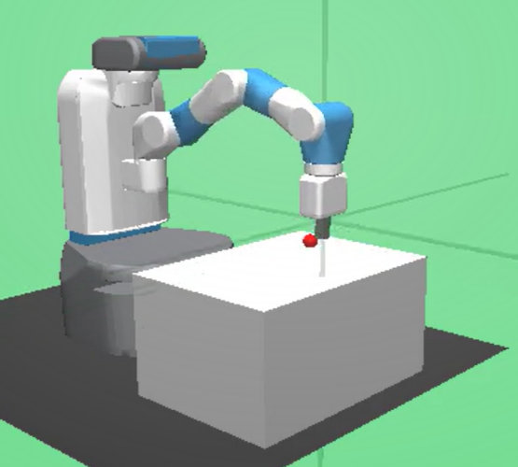
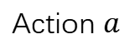
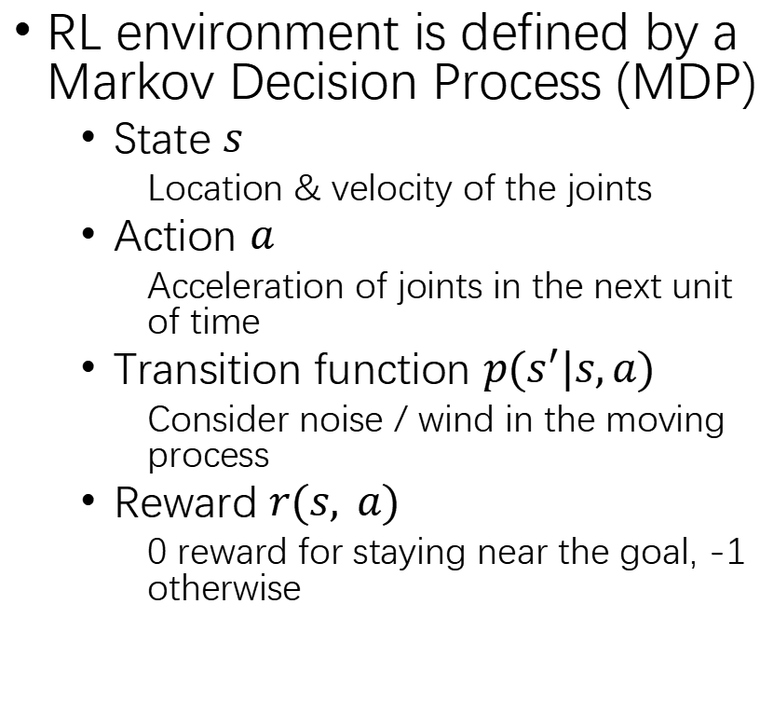
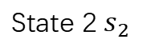
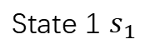
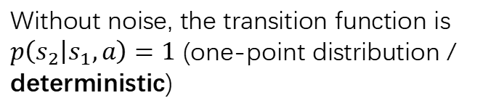
Reinforcement Learning: A Quick Recap
RL environment is defined by a Markov Decision Process (MDP)
State $s$
Location & velocity of the joints
Action $a$
Acceleration of joints in the next unit of time
Transition function $p(s^{′}|s,a)$
Consider noise / wind in the moving process
Reward $r(s, a)$
0 reward for staying near the goal, -1 otherwise
State 1 $s_{1}$
State 2$s_{2}$
Action $a$
Without noise, the transition function is
$p\left(s_{2} | s_{1},a\right)=1$ (one-point distribution /
deterministic)
*For simplicity, we do not discriminate state (ground truth status of environment) and observation (obtainable input).

Slide 4
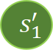
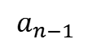
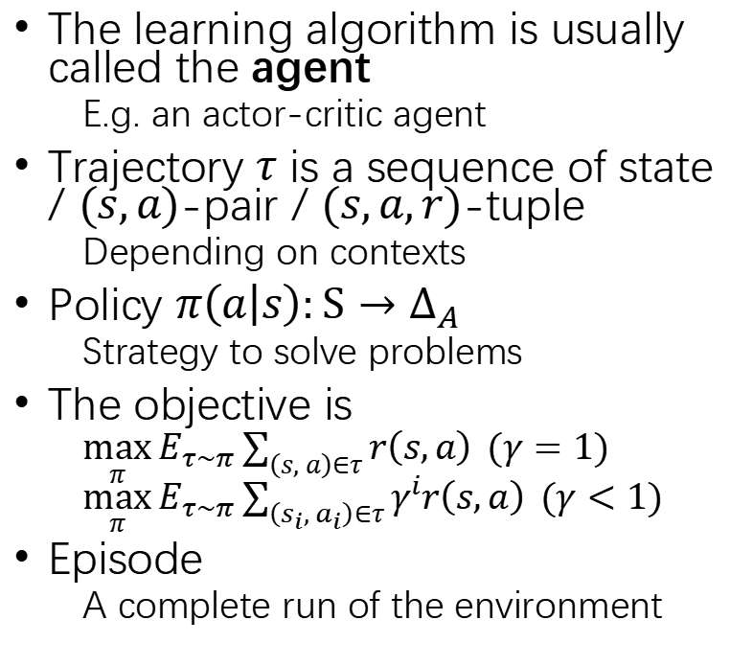
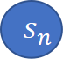
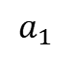
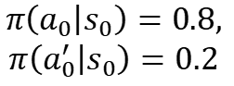
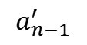
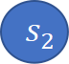
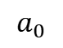
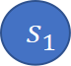
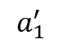
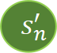
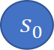
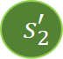
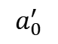
Reinforcement Learning: A Quick Recap
The learning algorithm is usually called the agent
E.g. an actor-critic agent
Trajectory $τ$ is a sequence of state / $(s,a)$-pair / $(s,a,r)$-tuple
Depending on contexts
Policy $π\left(a | s\right):S→Δ_{A}$
Strategy to solve problems
The objective is
$\max_{π}{E_{τ∼π}}\sum_{\left(s, a\right)∈τ}{r\left(s,a\right) }(γ=1)$ $\max_{π}{E_{τ∼π}}\sum_{\left(s_{i}, a_{i}\right)∈τ}{γ^{i}r\left(s,a\right) }(γ<1)$
Episode
A complete run of the environment
$$s_{0}$$
Initial state
a trajectory of
another episode
$$a_{0}^{′}$$
$$a_{0}$$
$$s_{1}^{′}$$
$$s_{1}$$
$$π\left(a_{0} | s_{0}\right)=0.8,$$
$$π\left(a_{0}^{′} | s_{0}\right)=0.2$$
$$a_{1}^{′}$$
$$a_{1}$$
$$s_{2}^{′}$$
$$s_{2}$$
…
…
$$a_{n−1}^{′}$$
$$a_{n−1}$$
a trajectory of
an episode
$$s_{n}^{′}$$
$$s_{n}$$
*Please refer to Yuanyi Zhong’s presentation for a more rigorous definition.
Notes:
Consider a “policy” in Rock-paper-scissors

Slide 5
Overview
Reinforcement Learning: A Quick Recap
What is Demonstration?
Why Demonstration?
What To Learn from Demonstration?
Policy: Behavioral Cloning
Reward function: Inverse RL
Policy, but segmented: Skill-based Learning
Transition model: Transition Model Retrieval
How to use Learned Policy?
Directly
Hierarchical
RL Regularizer
Normalizing-Flow Based
Conclusion & Takeaways
Notes:
Though I am talking about RL, this presentation will focus more on things that are not so “RL”, i.e. not so many tricks on Bellman equation.
Instead, we will focus more on general “representation of trajectories”

Slide 6
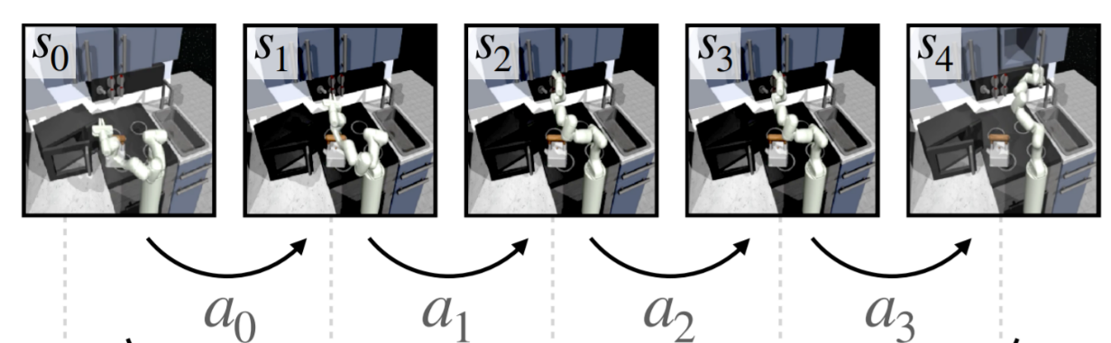
What is Demonstration?
Demonstration is a dataset of trajectories performed by an expert
The expert could be an RL agent, a script or a human
Demonstration is offline, i.e. static and fixed
The presence of an interactive expert is a very strong assumption
Why don’t we duplicate the expert in the first place?
Interactive demonstration usually fall into the category of active learning (if the agent can make queries, e.g. DAGGER[1]) or online learning (e.g. follow the regularized leader, FTRL)
Demonstration is supposed to contain “useful” information
Notes:
For this presentation, we assume demonstration to be offline. Interactive demonstration is beyond the scope of this presentation.
How to extract “useful” information is the core for RL with demonstrations.

Slide 7
What is Demonstration?
Demonstration can be of various kinds
State, action and reward
Offline reinforcement learning
State and action
Most common settings in demonstration-guided RL
Relatively easily recorded by a sensor
State only
Common in robotics
Pseudo-labeling[2]
First learn how to move between states, either by using metrics (e.g. distance) or train the labeling model on another demonstration dataset with action
Notes:
In the presentation below, we will focus on the settings where demonstration contains state and action, i.e. the second setting.

Slide 8
Overview
Reinforcement Learning: A Quick Recap
What is Demonstration?
Why Demonstration?
What To Learn from Demonstration?
Policy: Behavioral Cloning
Reward function: Inverse RL
Policy, but segmented: Skill-based Learning
Transition model: Transition Model Retrieval
How to use Learned Policy?
Directly
Hierarchical
RL Regularizer
Normalizing-Flow Based
Conclusion & Takeaways
Notes:
Though I am talking about RL, this presentation will focus more on things that are not so “RL”, i.e. not so many tricks on Bellman equation.
Instead, we will focus more on general “representation of trajectories”

Slide 9
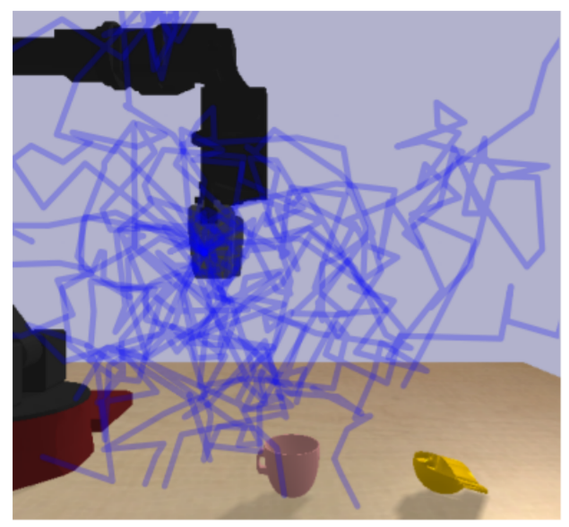
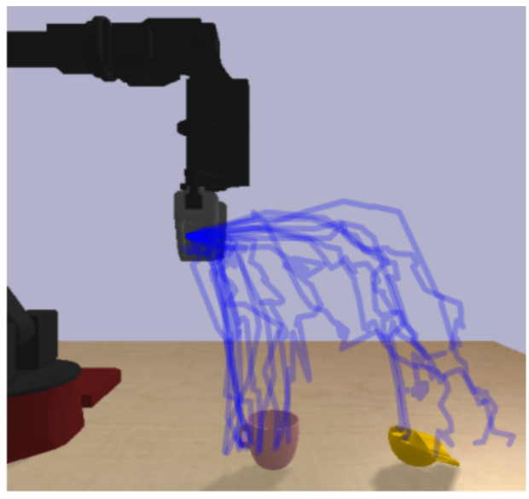
Why Demonstration?
Improve sampling complexity
common in robotics (complex action space & sparse reward)
Notes:
You have to know that you need to move near the item to do anything with it.

Slide 10
Overview
Reinforcement Learning: A Quick Recap
What is Demonstration?
Why Demonstration?
What To Learn from Demonstration?
Policy: Behavioral Cloning
Reward function: Inverse RL
Policy, but segmented: Skill-based Learning
Transition model: Transition Model Retrieval
How to use Learned Policy?
Directly
Hierarchical
RL Regularizer
Normalizing-Flow Based
Conclusion & Takeaways
Notes:
Though I am talking about RL, this presentation will focus more on things that are not so “RL”, i.e. not so many tricks on Bellman equation.
Instead, we will focus more on general “representation of trajectories”
Behavioral cloning and IRL are often called “imitation learning”

Slide 11
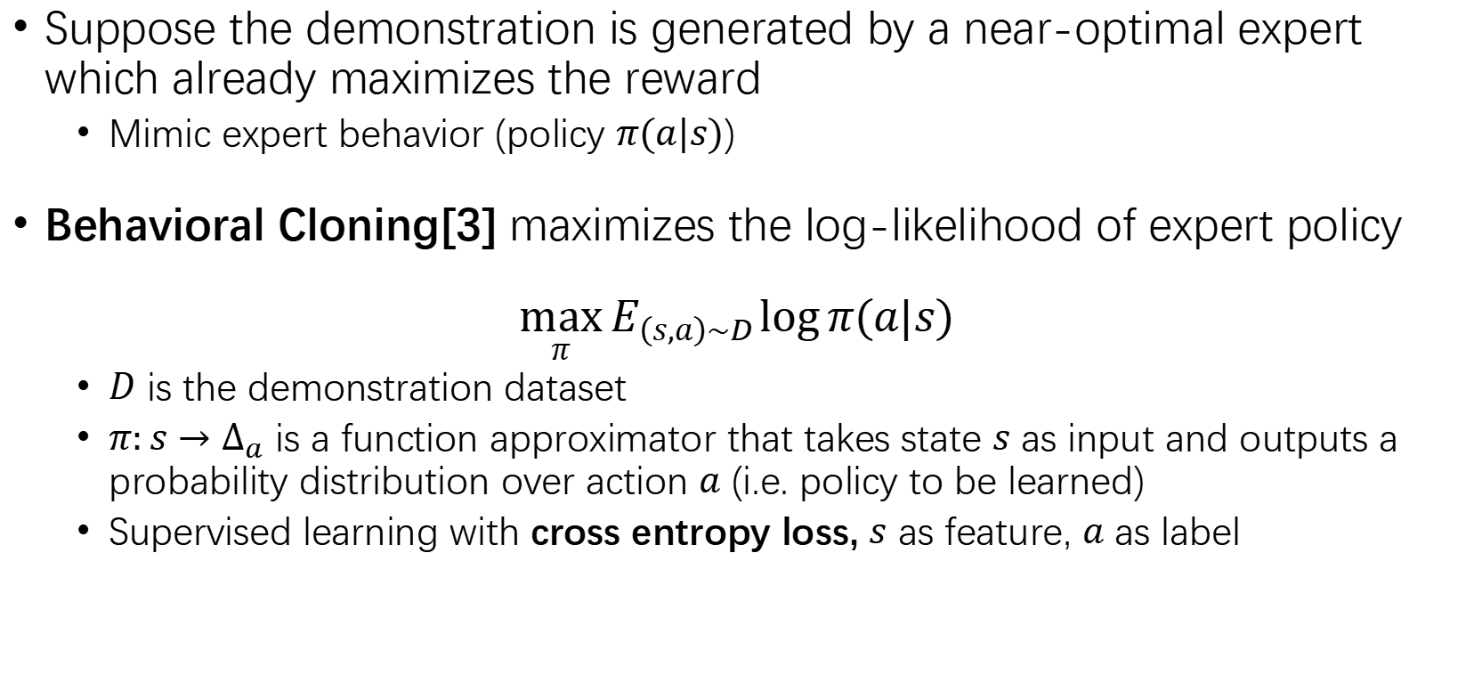
Behavioral Cloning
Suppose the demonstration is generated by a near-optimal expert which already maximizes the reward
Mimic expert behavior (policy $π(a|s)$)
Behavioral Cloning[3] maximizes the log-likelihood of expert policy
$$\max_{π}{E_{\left(s,a\right)∼D}}\log{π(a|s)}$$
$D$ is the demonstration dataset
$π:s→Δ_{a}$ is a function approximator that takes state $s$ as input and outputs a probability distribution over action $a$ (i.e. policy to be learned)
Supervised learning with cross entropy loss, $s$ as feature, $a$ as label
Notes:
given enough amount of data, we can simply mimic the behavior (i.e. policy $π(a|s)$) of the expert

Slide 12
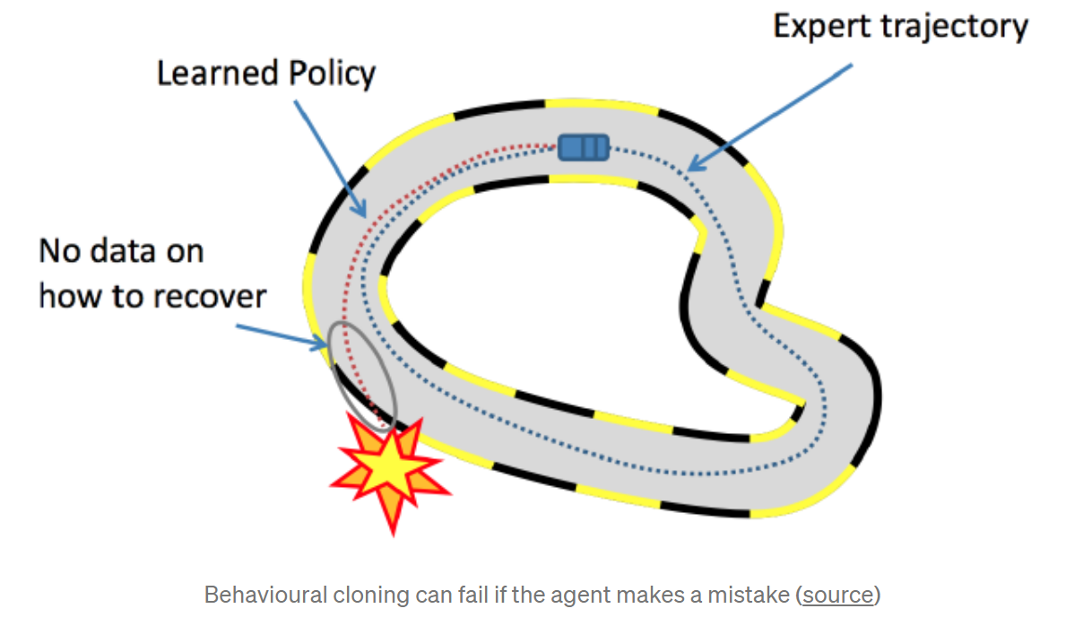
Downside of Behavioral Cloning
Behavioral Cloning is brittle!
Theoretically, error rate grows quadratically with the episode length[4]
Notes:
One fix of such method is to give interactive experience from the expert to tell the learner “what to do after messing up”, but again, an interactive teacher is a very strong assumption

Slide 13
Overview
Reinforcement Learning: A Quick Recap
What is Demonstration?
Why Demonstration?
What To Learn from Demonstration?
Policy: Behavioral Cloning
Reward function: Inverse RL
Policy, but segmented: Skill-based Learning
Transition model: Transition Model Retrieval
How to use Learned Policy?
Directly
Hierarchical
RL Regularizer
Normalizing-Flow Based
Conclusion & Takeaways
Notes:
Though I am talking about RL, this presentation will focus more on things that are not so “RL”, i.e. not so many tricks on Bellman equation.
Instead, we will focus more on general “representation of trajectories”

Slide 14
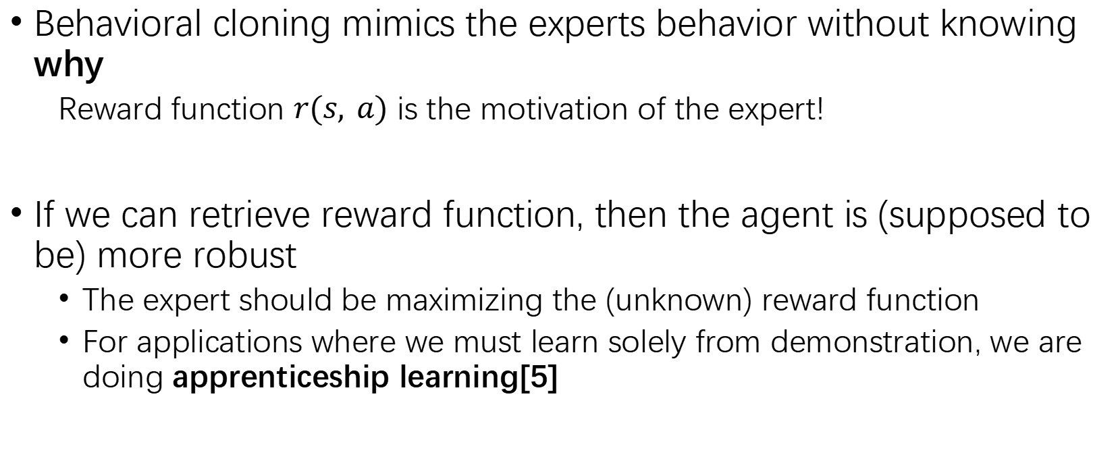
Inverse Reinforcement Learning (IRL)
Behavioral cloning mimics the experts behavior without knowing why
Reward function $r(s, a)$ is the motivation of the expert!
If we can retrieve reward function, then the agent is (supposed to be) more robust
The expert should be maximizing the (unknown) reward function
For applications where we must learn solely from demonstration, we are doing apprenticeship learning[5]

Slide 15
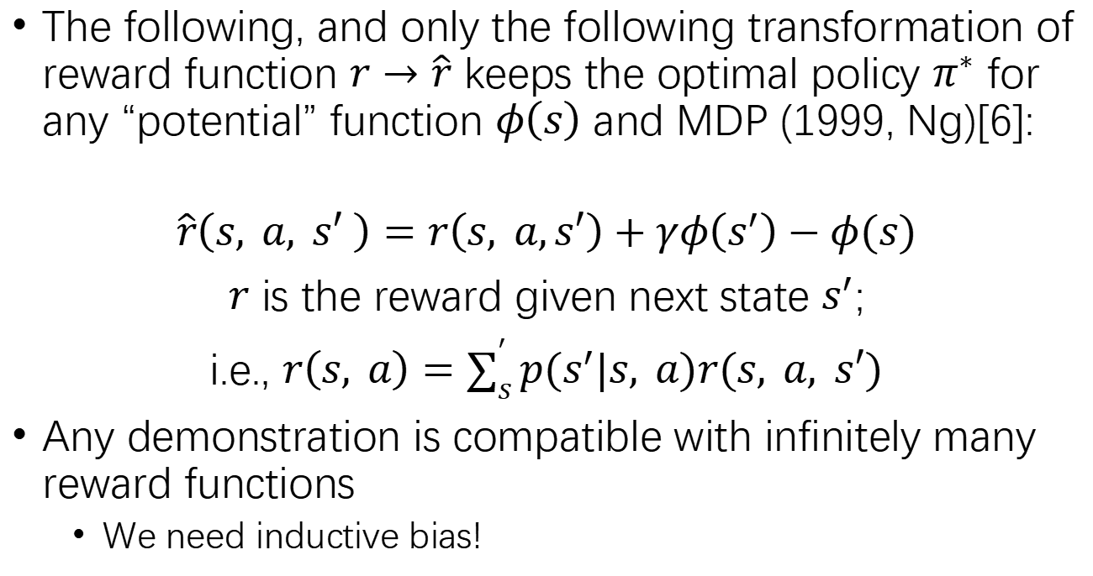
Ambiguity of IRL
-0.1
+1
The following, and only the following transformation of reward function $r→\hat{r}$ keeps the optimal policy $π^{∗}$ for any “potential” function $φ\left(s\right)$ and MDP (1999, Ng)[6]:
$$\hat{r}\left(s, a, s′ \right)=r\left(s, a,s′\right)+γφ\left(s^{′}\right)−φ(s)$$
$r$ is the reward given next state $s^{′}$;
i.e., $r\left(s, a\right)=\sum_{s}^{′}{p(s^{′}|s, a)r(s, a, s′)}$
Any demonstration is compatible with infinitely many reward functions
We need inductive bias!
？
$$φ\left(s\right)=−0.1+0.3∗(4−dist)$$
-.2
0.1
0.4
0.1
-.2
0.1
0.4
0.7
0.4
0.1
0.4
0.7
+1
0.7
0.4
0.1
0.4
0.7
0.4
0.1
-.2
0.1
0.4
0.1
-.2
Notes:
Ambiguity is the core problem of inverse RL.
Andrew Ng
For finite horizion MDP, there is a single absorb state at the end to “balance the potential”
This theorem is the basis of reward shaping, a common skill in RL that deals with sparse reward
Phi can be regarded as some “potential” of state, e.g. distance to goal
这个对于infinite horizon的MDP，gamma<1很好理解；如果是finite horizon，最后要加一个固定的吸收state来“平衡势能”。
Intuitively, you cannot have a negative loop
Potential function also has many use in game theory, as it does not discriminate between actions, usually becoming a “common incentive” (e.g. potential game)

Slide 16
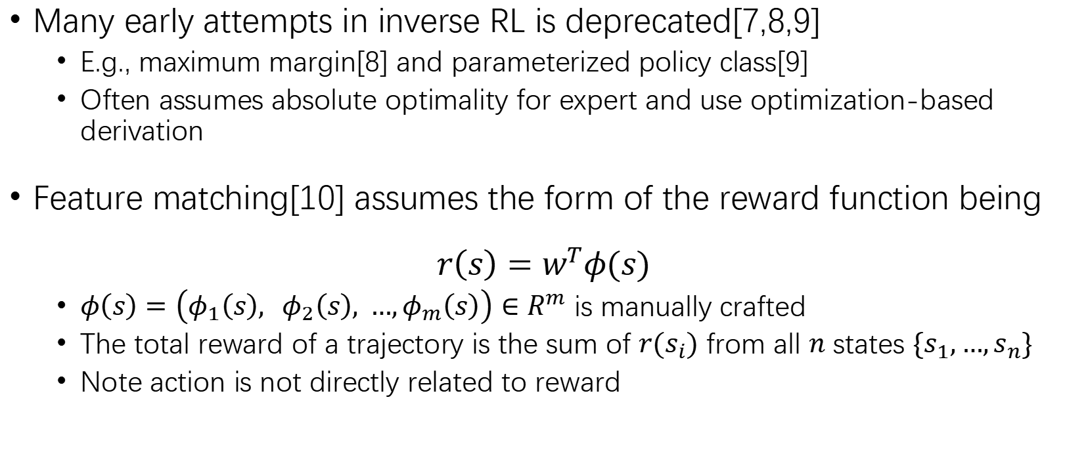
Feature Matching
Many early attempts in inverse RL is deprecated[7,8,9]
E.g., maximum margin[8] and parameterized policy class[9]
Often assumes absolute optimality for expert and use optimization-based derivation
Feature matching[10] assumes the form of the reward function being
$$r\left(s\right)=w^{T}φ(s)$$
$φ\left(s\right)=\left(φ_{1}\left(s\right), φ_{2}\left(s\right), …,φ_{m}\left(s\right)\right)∈R^{m}$ is manually crafted
The total reward of a trajectory is the sum of $r(s_{i})$ from all $n$ states $\{s_{1},…,s_{n}\}$
Note action is not directly related to reward
Notes:
Those attempts are all largely deprecated today, but feature matching is crucial for us to understand how model inverse RL evolves.
Here we will give an example of those early attempts, which is feature matching. This is also the basis of understanding maximum entropy IRL in the following paragraph,
https://people.eecs.berkeley.edu/~pabbeel/cs287-fa12/slides/inverseRL.pdf

Slide 17
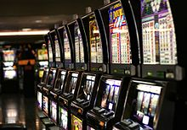
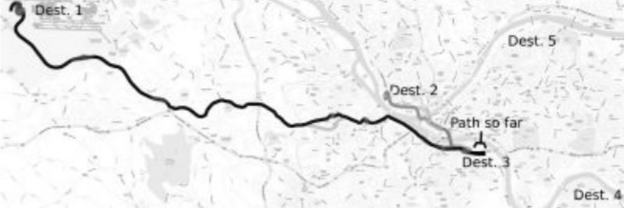
Examples of Such Reward Function
Example: Goal-based tasks (navigation)[11]
Counter Example: Multi-armed bandit
$s$ is current location, $φ(s)$ is speed limit, #lanes, etc.
only action (which lever to pull) matters

Slide 18
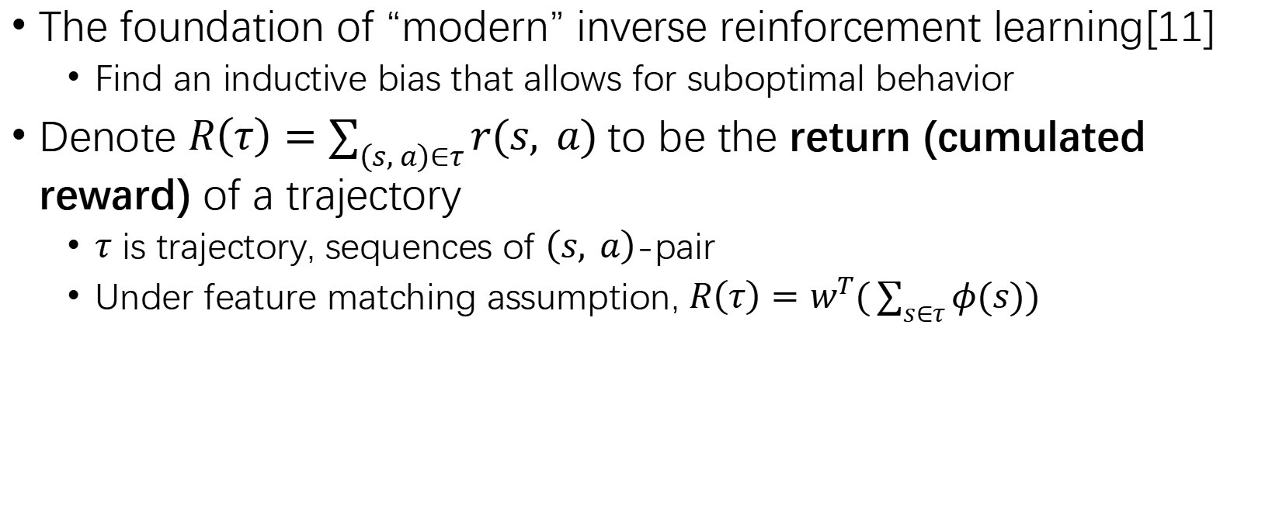
Maximum Entropy IRL
The foundation of “modern” inverse reinforcement learning[11]
Find an inductive bias that allows for suboptimal behavior
Denote $R\left(τ\right)=\sum_{\left(s, a\right)∈τ}{r(s, a)}$ to be the return (cumulated reward) of a trajectory
$τ$ is trajectory, sequences of $\left(s, a\right)$-pair
Under feature matching assumption, $R\left(τ\right)=w^{T}(\sum_{s∈τ}{φ(s))}$
Notes:
Again, For simplicity, we assume discount factor $γ=1$ and finite horizon (#steps).
Andrew imposes assumptions on the formulation of reward function
And uses linear programming; long deprecated in IRL.
Before 2008, people uses feature matching which assumes the reward function to be of limited formulation
Though there are inverse optimal control problem in control theory, The first paper of inverse reinforcement learning is by Andrew Ng published in 2000
Requires absolutely optimal demonstrations; deprecated since 2008

Slide 19
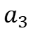
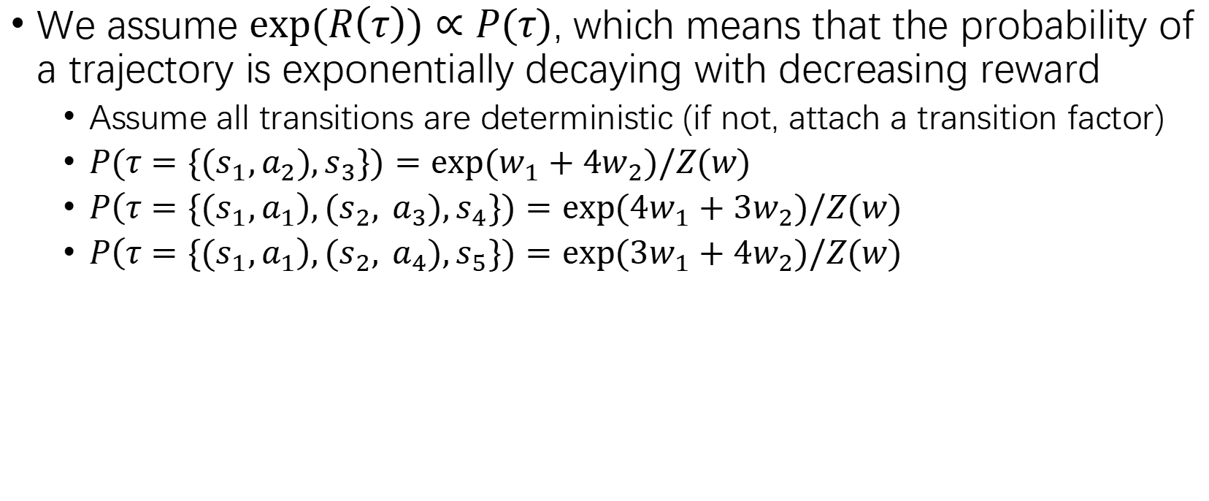
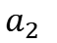
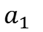

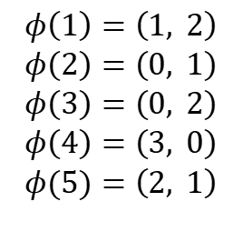
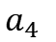
Maximum Entropy IRL
We assume $exp(R\left(τ\right))∝P(τ)$, which means that the probability of a trajectory is exponentially decaying with decreasing reward
Assume all transitions are deterministic (if not, attach a transition factor)
$P(τ=\{{(s}_{1},a_{2}),s_{3}\})=exp⁡(w_{1}+4w_{2})/Z(w)$
$P\left(τ=\{{(s}_{1},a_{1}\right),{(s}_{2}, a_{3}),s_{4}\})=exp⁡(4w_{1}+3w_{2})/Z(w)$
$P\left(τ=\{{(s}_{1},a_{1}\right),{(s}_{2}, a_{4}),s_{5}\})=exp⁡(3w_{1}+4w_{2})/Z(w)$
$$R\left(τ\right)=w^{T}(\sum_{\left(s, a\right)∈τ}{φ(s))}$$
State 2
$$a_{3}$$
State 4
$$φ\left(1\right)=\left(1, 2\right)$$
$$φ\left(2\right)=\left(0, 1\right)$$
$$φ\left(3\right)=\left(0, 2\right)$$
$$φ\left(4\right)=\left(3, 0\right)$$
$$φ(5)=\left(2, 1\right)$$
$$a_{1}$$
State 1
$$a_{2}$$
State 3
$$a_{4}$$
State 5
Notes:
Again, For simplicity, we assume discount factor $γ=1$ and finite horizon (#steps).
Andrew imposes assumptions on the formulation of reward function
And uses linear programming; long deprecated in IRL.
Before 2008, people uses feature matching which assumes the reward function to be of limited formulation
Though there are inverse optimal control problem in control theory, The first paper of inverse reinforcement learning is by Andrew Ng published in 2000
Requires absolutely optimal demonstrations; deprecated since 2008

Slide 20
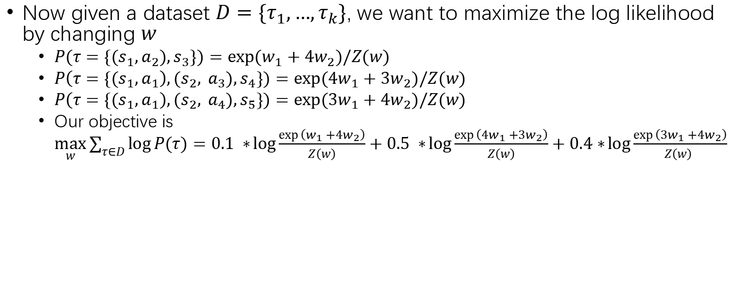
Maximum Entropy IRL
Now given a dataset $D=\{τ_{1},…,τ_{k}\}$, we want to maximize the log likelihood by changing $w$
$P(τ=\{{(s}_{1},a_{2}),s_{3}\})=exp⁡(w_{1}+4w_{2})/Z(w)$
$P\left(τ=\{{(s}_{1},a_{1}\right),{(s}_{2}, a_{3}),s_{4}\})=exp⁡(4w_{1}+3w_{2})/Z(w)$
$P\left(τ=\{{(s}_{1},a_{1}\right),{(s}_{2}, a_{4}),s_{5}\})=exp⁡(3w_{1}+4w_{2})/Z(w)$
Our objective is $\max_{w}{\sum_{τ∈D}{\log{P(τ)}}=0.1 ∗\log{\frac{\exp\left(w_{1}+4w_{2}\right)}{Z\left(w\right)}}+0.5 ∗\log{\frac{\exp\left(4w_{1}+3w_{2}\right)}{Z\left(w\right)}}+0.4∗\log{\frac{\exp\left(3w_{1}+4w_{2}\right)}{Z\left(w\right) }}}$
(90% trajectory)
State 2
$$a_{3}$$
State 2
State 4
State 4
(50% trajectory)
$$a_{1}$$
State 1
State 1
State 3
$$a_{4}$$
State 3
State 5
$$a_{2}$$
State 5
(40% trajectory)
(10% trajectory)
Notes:
Note this is not linear, as Z(w) exists!
And note this is
Again, For simplicity, we assume discount factor $γ=1$ and finite horizon (#steps).
Andrew imposes assumptions on the formulation of reward function
And uses linear programming; long deprecated in IRL.
Before 2008, people uses feature matching which assumes the reward function to be of limited formulation
Though there are inverse optimal control problem in control theory, The first paper of inverse reinforcement learning is by Andrew Ng published in 2000
Requires absolutely optimal demonstrations; deprecated since 2008

Slide 21
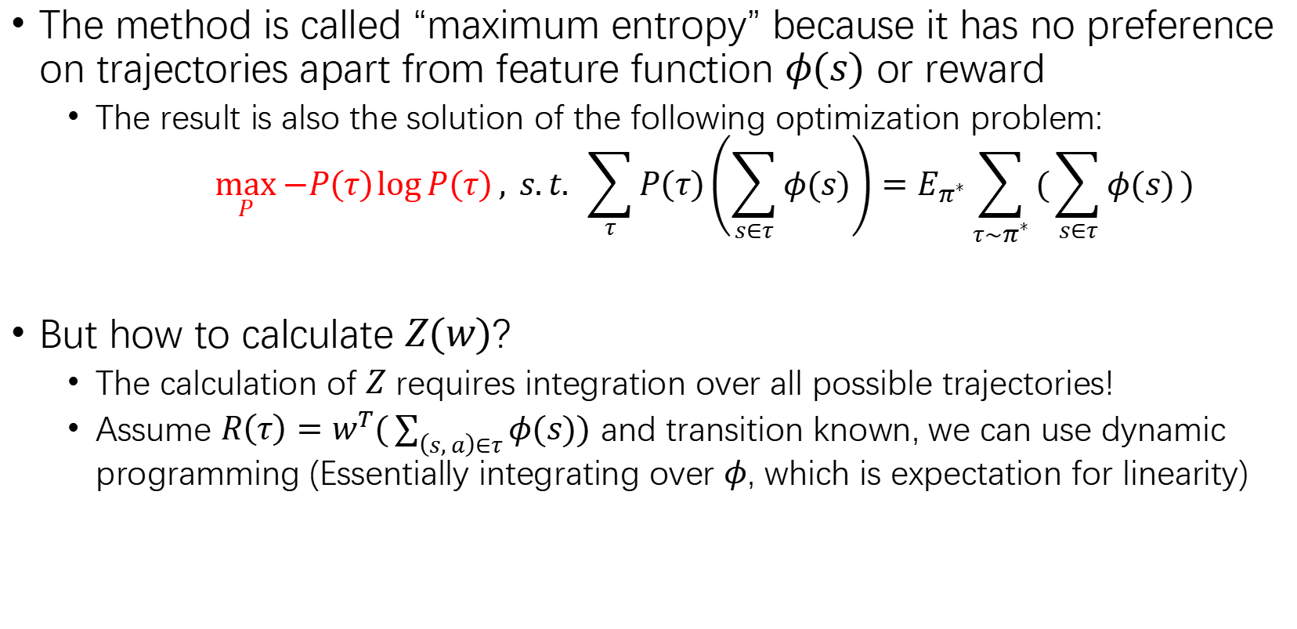
Maximum Entropy IRL
The method is called “maximum entropy” because it has no preference on trajectories apart from feature function $φ(s)$ or reward
The result is also the solution of the following optimization problem:
$$\max_{P}{−P\left(τ\right)\log{P\left(τ\right)}, s.t. }\sum_{τ}{P\left(τ\right)\left(\sum_{s∈τ}{φ(s)}\right)=E_{π^{∗}}\sum_{τ∼π^{∗}}{(\sum_{s∈τ}{φ(s)})}}$$
But how to calculate $Z(w)$?
The calculation of $Z$ requires integration over all possible trajectories!
Assume $R\left(τ\right)=w^{T}(\sum_{\left(s, a\right)∈τ}{φ(s))}$ and transition known, we can use dynamic programming (Essentially integrating over $φ$, which is expectation for linearity)

Slide 22
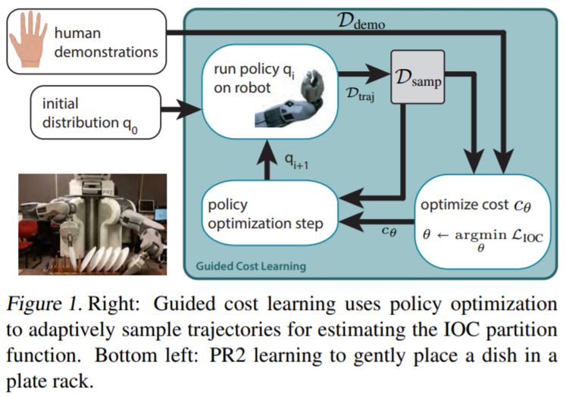
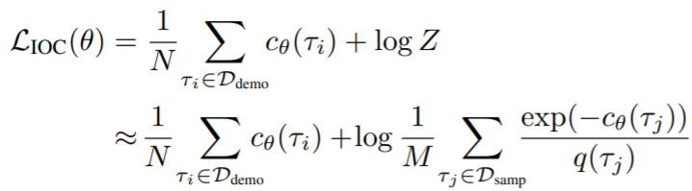
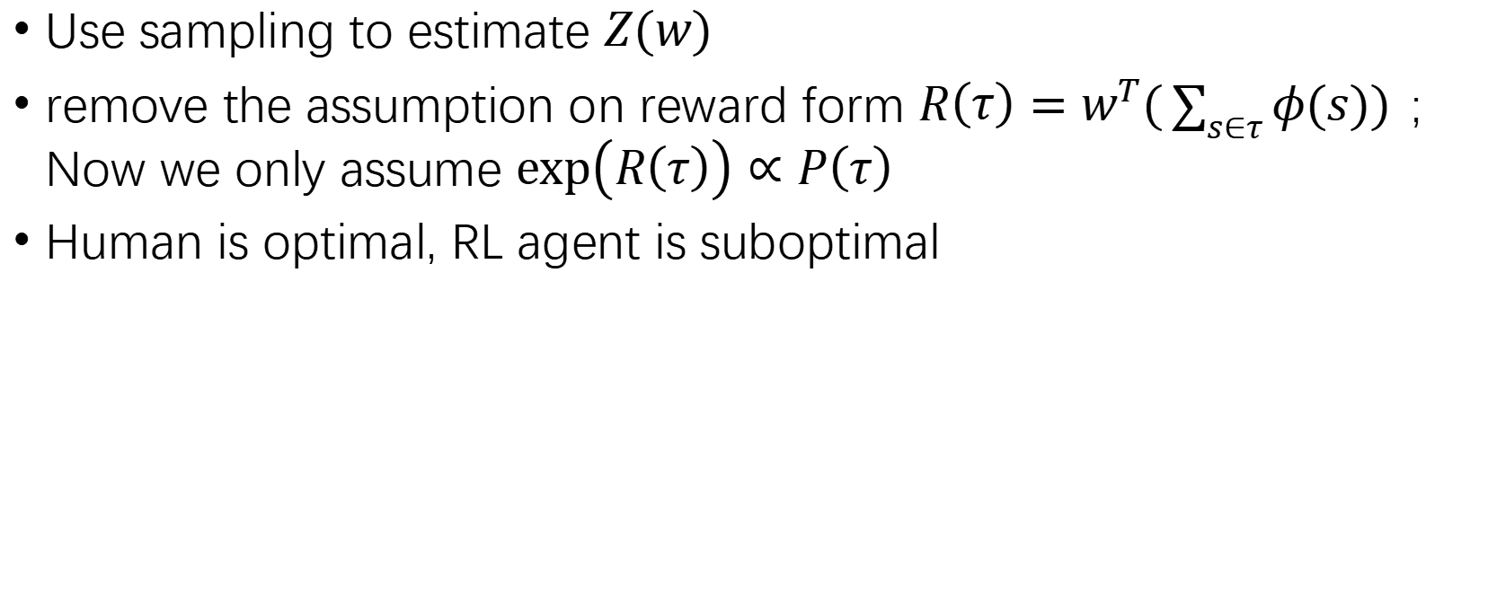
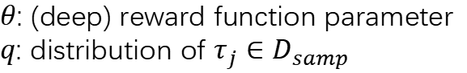
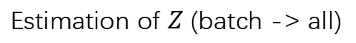
Guided Cost Learning[12]
Use sampling to estimate $Z(w)$
remove the assumption on reward form $R\left(τ\right)=w^{T}(\sum_{s∈τ}{φ(s))}$; Now we only assume $exp\left(R\left(τ\right)\right)∝P\left(τ\right)$
Human is optimal, RL agent is suboptimal
$θ$: (deep) reward function parameter
$q$: distribution of $τ_{j}∈D_{samp}$
Cost(negative reward)
Estimation of $Z$ (batch -> all)
Notes:
It iteratively optimize reward function and policy. For the reward function optimization, it assumes the expert (D_demo) is optimal (which is why it is optimizing the reward of expert), and the sample batch is suboptimal, which is why it uses MEIRL for the RL policy

Slide 23
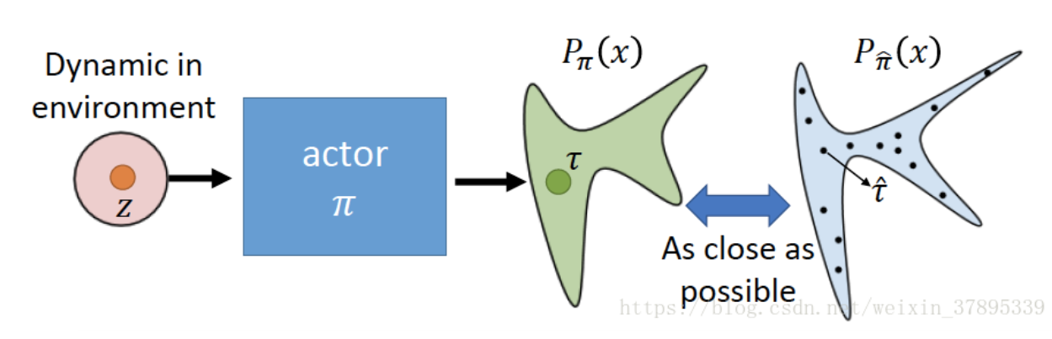
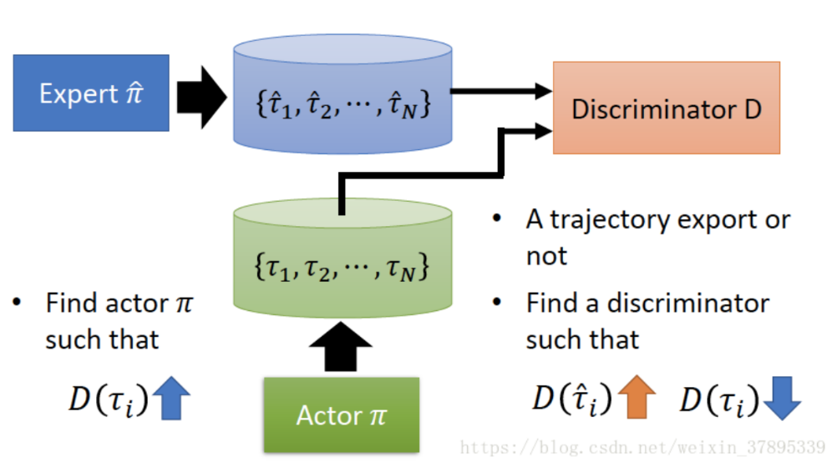
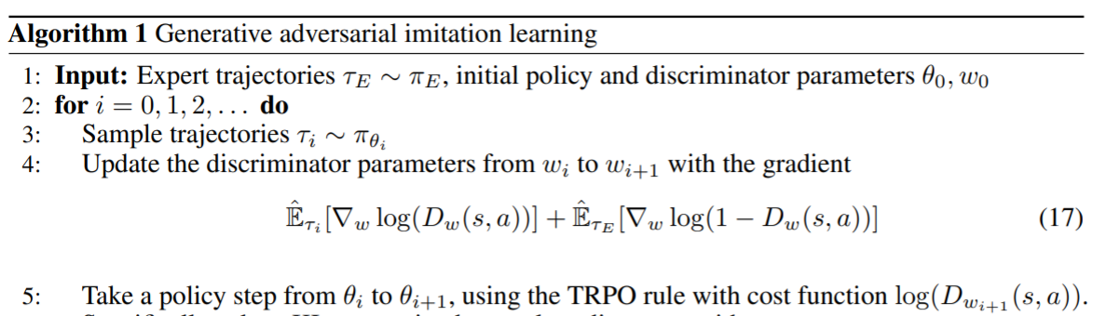
GAIL[13]
An extension of GAN on reinforcement learning
Notes:
While there are many math behind this formula, I invite you to see original paper for those math; I will only adopt the most intuitive idea here.
You don’t need to know what TRPO is, just comprehend the idea.

Slide 24
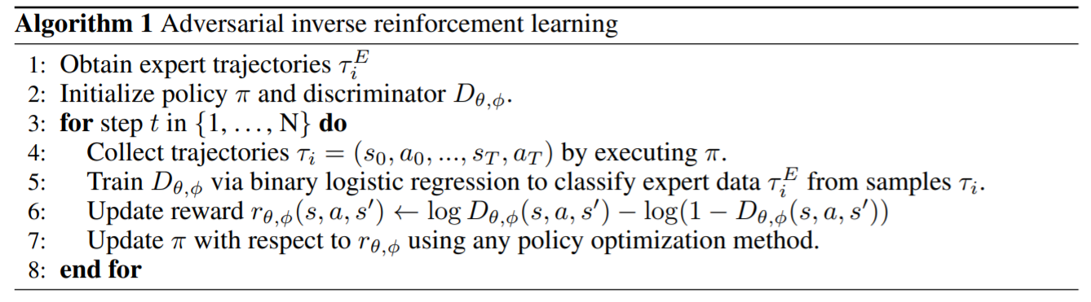

AIRL[14]
Though GAIL is born from inverse RL ideas, it is unable to recover reward functions
Structured Reward Approximator
$$f_{θ,φ}\left(s,a,s′\right)=g_{θ}\left(s,a\right)+γh_{φ}\left(s^{′}\right)−h_{φ}(s)$$
At optimal, we have $g_{θ}^{∗}\left(s, a\right)=r\left(s,a\right)+c$, $h_{φ}^{∗}\left(s\right)=V^{∗}\left(s\right)+c$
maximize generator loss

Slide 25

IRL, GAN and Energy-based Model[15]
Energy-based models assigns “energy” $E_{θ}\left(x\right)$ to a sample $x$, and model the data as a Boltzmann distribution
$$p_{θ}\left(x\right)=\frac{1}{Z}exp⁡(−E_{θ}(x))$$
commonly people sample from $p_{θ}(x)$ to estimate $Z$.
In IRL, $x$ is a trajectory (or $\left(s,a\right)$-pair if disentangled) and reward is the “energy”

Slide 26





Downside of IRL
Hard to train; inaccurate
GAIL has all the shortcomings of GAN
Maximum entropy IRL often can only recover “trend”
Ground truth
MaxEnt IRL
Recovered Policy
MaxEnt Deep IRL
Linear Programming

Slide 27


Zhenggang’s Dilemma
Energy-based method can sometimes be either missing patterns or hard to find patterns
Consider 64 actions at state $s$; only 3 actions are good
Hard to find patterns
$$π\left(a_{1,1} | s\right)=\frac{\exp\left(0.9\right)}{Z}≈0.082$$
$$π\left(a_{3,4} | s\right)=\frac{\exp\left(1\right)}{Z}≈0.091$$
$$π\left(a_{6,5} | s\right)=\frac{\exp\left(0.8\right)}{Z}≈0.074$$
$$Z=\exp\left(0.9\right)+\exp\left(1\right)+\exp\left(0.8\right)+61∗\exp\left(−1\right)≈29.844$$
0, 1, 2, 3, 4, 5, 6, 7
0,
1,
2,
3,
4,
5,
6,
7
.9
1
.8
Other reward -1

Slide 28


Zhenggang’s Dilemma
One common practice (e.g. by soft actor-critic, SAC) is to scale the exp term
If $A$ is too large, then probability will converge to $a_{3,4}$ and hinders exploration (as estimation could be inaccurate)
$$π\left(a_{1,1} | s\right)=\frac{\exp\left(0.9/A\right)}{Z}≈0.245$$
$$π\left(a_{3,4} | s\right)=\frac{\exp\left(1/A\right)}{Z}≈0.665$$
$$π\left(a_{6,5} | s\right)=\frac{\exp\left(0.8/A\right)}{Z}≈0.090$$
$$A=0.1$$
$$Z=\exp\left(0.9/A\right)+\exp\left(1/A\right)+\exp\left(0.8/A\right)+61∗\exp\left(−\frac{1}{A}\right)≈33110.51$$
0, 1, 2, 3, 4, 5, 6, 7
0,
1,
2,
3,
4,
5,
6,
7
.9
1
.8
Other reward -1

Slide 29
Overview
Reinforcement Learning: A Quick Recap
What is Demonstration?
Why Demonstration?
What To Learn from Demonstration?
Policy: Behavioral Cloning
Reward function: Inverse RL
Policy, but segmented: Skill-based Learning
Transition model: Transition Model Retrieval
How to use Learned Policy?
Directly
Hierarchical
RL Regularizer
Normalizing-Flow Based
Conclusion & Takeaways
Notes:
Though I am talking about RL, this presentation will focus more on things that are not so “RL”, i.e. not so many tricks on Bellman equation.
Instead, we will focus more on general “representation of trajectories”

Slide 30
Skill-based Learning
Suppose you want to train robotic arms to move items
Regardless of where you move, you need to move near the item and grasp it
Commonly used in environments with long episodes (e.g. 200~300)
Skills serve as “low-level actions”, which is embedded into a latent space
The RL agent, instead of selecting actions, selects “skills” from the space
If we manually set what the skills are and give the RL agent APIs of the skills, then it is Parameterized Action MDP (PAMDP)[16]

Slide 31


SPiRL[17]
Use VAE to extract skills; skill is an action sequence $a_{1},…,a_{H}$
$L_{rec}$ (reconstruction loss) and $L_{reg}$ (regularizing to $N(0, I)$) are the same meaning as that in any VAE
Accelerating Reinforcement Learning with Learned Skill Priors， CoRL 20’
Notes:
Accelerating Reinforcement Learning with Learned Skill Priors

Slide 32

SPiRL
$L_{prior}=KL(p(z|s_{1})||q(z|a_{1},…,a_{H}))$ is approximating what skills to use as an expert when observing a state
Note we have no access to future action in RL for choosing $z$
$p(z|s_{1})$ is the learned expert policy
Notes:
We left “how to use policy” part in the next part of our presentation.

Slide 33


SKiLD[18]
Demonstration-Guided Reinforcement Learning with Learned Skills
What if we have both a task-agnostic dataset $D$ and a task-specific dataset $D_{demo}$?
We first use the same idea from SPiRL to get two sets of priors / expert policies (called posterior for $D_{demo}$), except that we feed starting state into the decoder of VAE
Then we train a discriminator $D(s)$ to decide which prior to use

Slide 34
Overview
Reinforcement Learning: A Quick Recap
What is Demonstration?
Why Demonstration?
What To Learn from Demonstration?
Policy: Behavioral Cloning
Reward function: Inverse
RLPolicy, but segmented: Skill-based Learning
Transition model: Transition Model Retrieval
How to use Learned Policy?
Directly
Hierarchical
RL Regularizer
Normalizing-Flow Based
Conclusion & Takeaways
Notes:
Though I am talking about RL, this presentation will focus more on things that are not so “RL”, i.e. not so many tricks on Bellman equation.
Instead, we will focus more on general “representation of trajectories”

Slide 35

Transition Model Retrieval
If the demonstration is not optimal, but diverse enough (preferably uniform), we can retrieve the transition function of RL
Closely related to model-based reinforcement Learning[19]
[18] TRAIL: Near-Optimal Imitation Learning With Suboptimal Data

Slide 36
Overview
Reinforcement Learning: A Quick Recap
What is Demonstration?
Why Demonstration?
What To Learn from Demonstration?
Policy: Behavioral Cloning
Reward function: Inverse RL
Policy, but segmented: Skill-based Learning
Transition model: Transition Model Retrieval
How to use Learned Policy?
Directly
Hierarchical
RL Regularizer
Normalizing-Flow Based
Conclusion & Takeaways
Notes:
Though I am talking about RL, this presentation will focus more on things that are not so “RL”, i.e. not so many tricks on Bellman equation.
Instead, we will focus more on general “representation of trajectories”

Slide 37

Accept the Learned Expert Policy
Many algorithms directly use the learned policy for evaluation without RL finetuning
e.g. behavioral cloning, inverse RL (two main components of imitation learning)

Slide 38


Hierarchical Usage of Skills
$$s$$
RL Agent
$$z$$
Prior
$$a$$
Env
Notes:
We will take SPIRL as an example

Slide 39

RL Regularizer
Solve RL under the constraint $E_{τ}\left[KL\left(π||π_{prior}\right) | s∼τ\right]≤ϵ$[20]
Add a term $−αKL(π(a|s)||π_{prior}(a|s))$ onto reward[17,18]
Give reward for approaching the states that are frequently appearing in demonstration (more “familiar” to learned policy)[18]
The metric of approaching can be learned by contrastive learning
Notes:
KEEP DOING WHAT WORKED: BEHAVIOR MODELLING PRIORS FOR OFFLINE REINFORCEMENT LEARNING

Slide 40

Preliminary: Normalizing Flow
An invertible transformation of probability distributions[21]
Can be trained for density estimation & sampling / variational inference

Slide 41

Flow-Based Model
$$s$$
RL Agent
$$z$$
Flow
$$a$$
Learn a distribution transformation[22];
Transform very bad initial policy to good ones
Env
[22]Parrot: Data-Driven Behavioral Priors for Reinforcement Learning

Slide 42
Overview
Reinforcement Learning: A Quick Recap
What is Demonstration?
Why Demonstration?
What To Learn from Demonstration?
Policy: Behavioral Cloning
Reward function: Inverse RL
Policy, but segmented: Skill-based Learning
Transition model: Transition Model Retrieval
How to use Learned Policy?
Directly
Hierarchical
RL Regularizer
Normalizing-Flow Based
Conclusion & Takeaways
Notes:
Though I am talking about RL, this presentation will focus more on things that are not so “RL”, i.e. not so many tricks on Bellman equation.
Instead, we will focus more on general “representation of trajectories”

Slide 43
Conclusion & TakeAways
Demonstrations can greatly improve the efficiency of reinforcement learning
There are many things to learn from demonstrations, including policy (behavioral cloning), reward (inverse RL), skill (skill-based learning) and transition model
We can directly use learned expert policy (imitation learning), or use the expert policy in low-level actions (hierarchical), finetune it with RL (RL regularizer), or in a normalizing-flow-based way

Slide 44
Reference
[1] Ross, Stéphane et al. “A Reduction of Imitation Learning and Structured Prediction to No-Regret Online Learning.” AISTATS (2011).
[2] Chang, M., Gupta, A., & Gupta, S. (2020). Semantic Visual Navigation by Watching YouTube Videos. In the proceedings of the 34th Conference on Neural Information Processing Systems (NeurIPS), 2020.
[3] D. A. Pomerleau. Alvinn: An autonomous land vehicle in a neural network. Technical report, Carnegie Melon Univ. Pittsburgh, PA. Artificial Intelligence and Psychology., 1989.
[4] S. Ross and J. A. Bagnell. Efficient reductions for imitation learning. In Proceedings of the 13th International Conference on Artificial Intelligence and Statistics (AISTATS), 2010.
[5] Abbeel, Pieter & Ng, Andrew. (2004). Apprenticeship Learning via Inverse Reinforcement Learning. Proceedings, Twenty-First International Conference on Machine Learning, ICML 2004. 10.1007/978-0-387-30164-8_417.
[6] Ng, A. et al. “Policy Invariance Under Reward Transformations: Theory and Application to Reward Shaping.” ICML (1999).
[7] Andrew Y. Ng and Stuart J. Russell. 2000. Algorithms for Inverse Reinforcement Learning. In Proceedings of the Seventeenth International Conference on Machine Learning (ICML '00). Morgan Kaufmann Publishers Inc., San Francisco, CA, USA, 663–670.
[8] Ratliff, Nathan & Bagnell, J. & Zinkevich, Martin. (2006). Maximum margin planning. 729-736. 10.1145/1143844.1143936.
[9] Deepak Ramachandran and Eyal Amir. 2007. Bayesian inverse reinforcement learning. In Proceedings of the 20th international joint conference on Artifical intelligence (IJCAI'07). Morgan Kaufmann Publishers Inc., San Francisco, CA, USA, 2586–2591.
[10] Umar Syed and Robert E. Schapire. 2007. A game-theoretic approach to apprenticeship learning. In Proceedings of the 20th International Conference on Neural Information Processing Systems (NIPS'07). Curran Associates Inc., Red Hook, NY, USA, 1449–1456.
[11] Brian D. Ziebart, Andrew Maas, J. Andrew Bagnell, and Anind K. Dey. 2008. Maximum entropy inverse reinforcement learning. In Proceedings of the 23rd national conference on Artificial intelligence - Volume 3 (AAAI'08). AAAI Press, 1433–1438.
[12] Chelsea Finn, Sergey Levine, and Pieter Abbeel. 2016. Guided cost learning: deep inverse optimal control via policy optimization. In Proceedings of the 33rd International Conference on International Conference on Machine Learning - Volume 48 (ICML'16). JMLR.org, 49–58.
[13] Ho, Jonathan and Stefano Ermon. “Generative Adversarial Imitation Learning.” NIPS (2016).
[14] J. Sun, L. Yu, P. Dong, B. Lu and B. Zhou, "Adversarial Inverse Reinforcement Learning With Self-Attention Dynamics Model," in IEEE Robotics and Automation Letters, vol. 6, no. 2, pp. 1880-1886, April 2021, doi: 10.1109/LRA.2021.3061397.
[15] Finn, C., Christiano, P.F., Abbeel, P., & Levine, S. (2016). A Connection between Generative Adversarial Networks, Inverse Reinforcement Learning, and Energy-Based Models. ArXiv, abs/1611.03852.
[16] Nasiriany, Soroush & Liu, Huihan & Zhu, Yuke. (2021). Augmenting Reinforcement Learning with Behavior Primitives for Diverse Manipulation Tasks.
[17] Karl Pertsch et al., Accelerating Reinforcement Learning with Learned Skill Priors, in the proceedings of the 4th Conference on Robot Learning, 2020.
[18] Karl Pertsch et al., Demonstration-Guided Reinforcement Learning with Learned Skills, in the proceedings of the 5th Conference on Robot Learning, 2021.
[19] Yang, Mengjiao & Levine, Sergey & Nachum, Ofir. (2021). TRAIL: Near-Optimal Imitation Learning with Suboptimal Data. In the proceedings of the 8th International Conference on Learning Representations (ICLR), 2020.
[20] Siegel, Noah & Springenberg, Jost & Berkenkamp, Felix & Abdolmaleki, Abbas & Neunert, Michael & Lampe, Thomas & Hafner, Roland & Riedmiller, Martin. (2020). Keep Doing What Worked: Behavioral Modelling Priors for Offline Reinforcement Learning.
[21] Kobyzev I, Prince SJD, Brubaker MA. Normalizing Flows: An Introduction and Review of Current Methods. IEEE Trans Pattern Anal Mach Intell. 2021 Nov;43(11):3964-3979. doi: 10.1109/TPAMI.2020.2992934. Epub 2021 Oct 1. PMID: 32396070.
[22] Singh, A., Liu, H., Zhou, G., Yu, A., Rhinehart, N., & Levine, S. (2021). Parrot: Data-Driven Behavioral Priors for Reinforcement Learning. In the proceedings of the 9th International Conference on Learning Representations (ICLR), 2021.

Slide 45
Thank you for Listening!
Any question?

